Slide 1
The E-Filing
Procedure and Process for Criminal

Slide 2
Points of Interest
Document Format
Form/Template Modifications
Pro Se’s and Unrepresented Interested Parties –Designation of Email vs. No Designation of Email
Form Retention
E Doc Submission
What happens if done wrong?
What should my email look like?
What should I be getting if done correctly?
Tips and Exceptions
Notes:
________________________________________________________________________________________________________________________________________________________________________________________________________________

Slide 3

Document Format
Formats accepted:
-Word 97-2002 document (.doc)
-Word 2003-present document (.docx)
*Please note no other document format is acceptable at this time (e.g., PDFs, RTF’s, WPD’s, etc) are not acceptable and must be converted by attorney to word docs before sending to JA/Judge
Notes:
________________________________________________________________________________________________________________________________________________________________________________________________________________

Slide 4
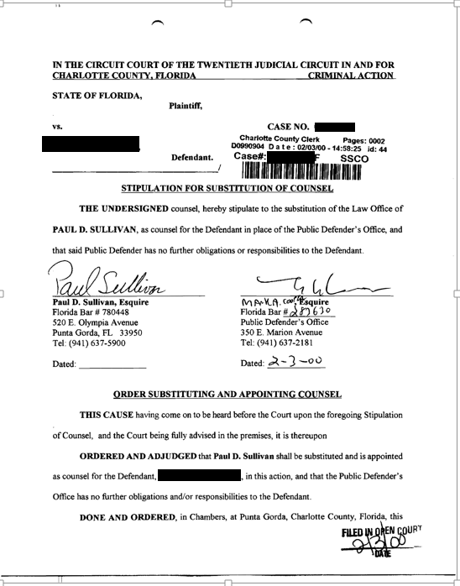
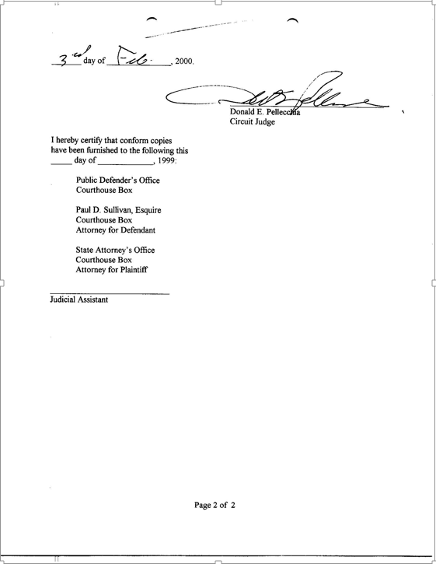
Form/Template Modifications
What it looked like before
Notice the signature line
Note the cc: or service list area
Note Done and Ordered Line
Notes:
________________________________________________________________________________________________________________________________________________________________________________________________________________

Slide 5
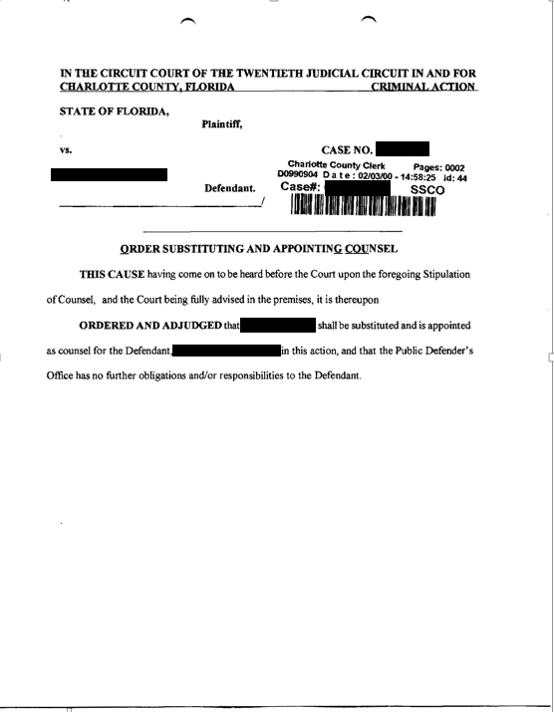
Form/Template Modification
What it should look like now:
No Done and Ordered paragraph
No signature line
No cc: or Service List Area
Stip’s sent to CLERK directly as PDF’s
Notes:
________________________________________________________________________________________________________________________________________________________________________________________________________________

Slide 6
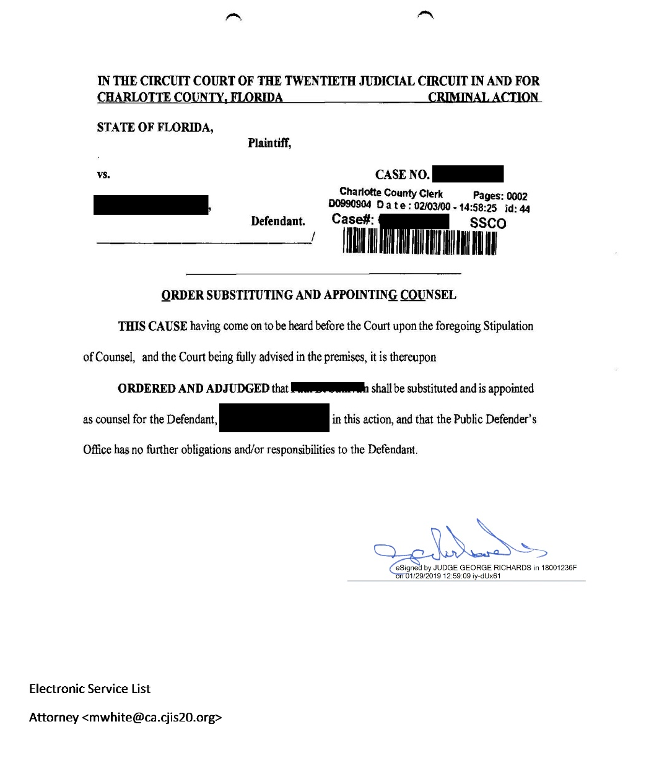
WHAT FORM WILL LOOK LIKE ONCE DONE
Notes:
________________________________________________________________________________________________________________________________________________________________________________________________________________

Slide 7
PRO SE’S AND UNREPRESENTED INTERESTED PARTIES
Designation of Emails
Court strongly recommends that you encourage all parties who must be served to provide their email for the portal to serve them.
Not mandatory for non-attorney parties/interested persons
www.flcourts.org for instructions on how to register their email
Notes:
________________________________________________________________________________________________________________________________________________________________________________________________________________

Slide 8

PRO SE’S AND UNREPRESENTED INTERESTED PARTIES
Non-Designation of Emails
No email designation? Court will print copies and mail.
Attorney must submit name and address of all parties who must be served by USPS in body of email
JA will manually add the party to the service list on the proposed order.
For further detail, please refer to Submission of Electronic Orders (see handout)
Notes:
________________________________________________________________________________________________________________________________________________________________________________________________________________

Slide 9
Form Retention
Save your forms locally and keep previous format
In the event that there are any computer issues, the previous format will be used
Notes:
________________________________________________________________________________________________________________________________________________________________________________________________________________

Slide 10
E-Doc Submission
Cha-felonyb@ca.cjis20.org (For Judge McFee)
Cha-felonya@ca.cjis20.org (For Judge Lisa Porter)
Each order sent as separate attachment
One order and signed and efiled stip/motion per email
Notes:
________________________________________________________________________________________________________________________________________________________________________________________________________________

Slide 11

What happens if done wrong?
EMAILS sent to wrong address
  Order may be delayed
  Order may be missed completely
Notes:
________________________________________________________________________________________________________________________________________________________________________________________________________________

Slide 12

What happens if done wrong?
Document not “modified” (i.e. “stripped”)
  Will be rejected
Wrong document format sent
  Will be rejected
Notes:
________________________________________________________________________________________________________________________________________________________________________________________________________________

Slide 13
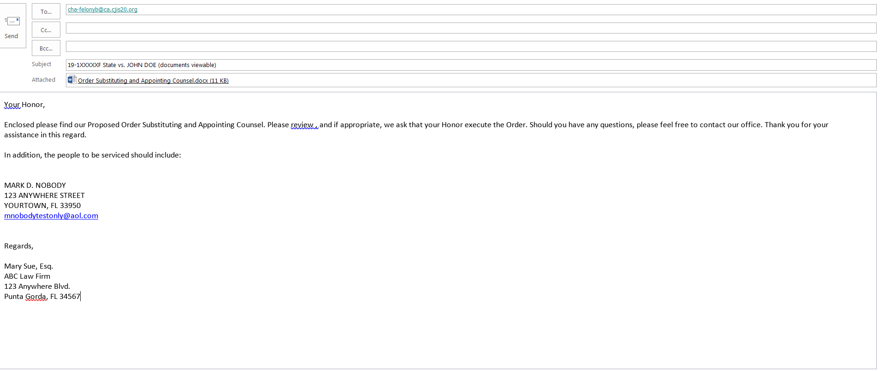
What should my email look like?
Notes:
________________________________________________________________________________________________________________________________________________________________________________________________________________

Slide 14
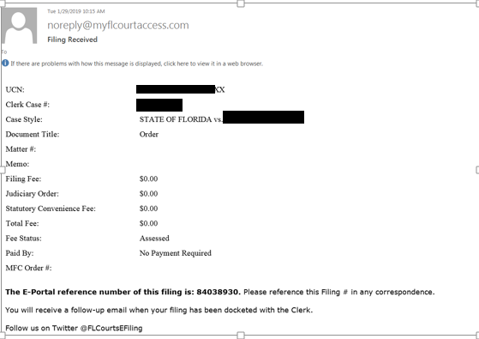
What you should be getting once order is processed
Notes:
________________________________________________________________________________________________________________________________________________________________________________________________________________

Slide 15
Tips and Exceptions
    Prior to first submission ONLY send a test email to each of the two email addresses and wait for confirmation from J.A. Put “Test” in the subject line.
    Body of Email now constitutes your cover letter
    CC (carbon copy) opposing counsel on submission email
    Judges require “courtesy copy” of stipulations/motions once filed with clerk
Notes:
________________________________________________________________________________________________________________________________________________________________________________________________________________

Slide 16

End

